Slide 1


A framework for debate analysis
András Meleg, 17/12/2019
Széchenyi István College for Advanced Studies

Slide 2
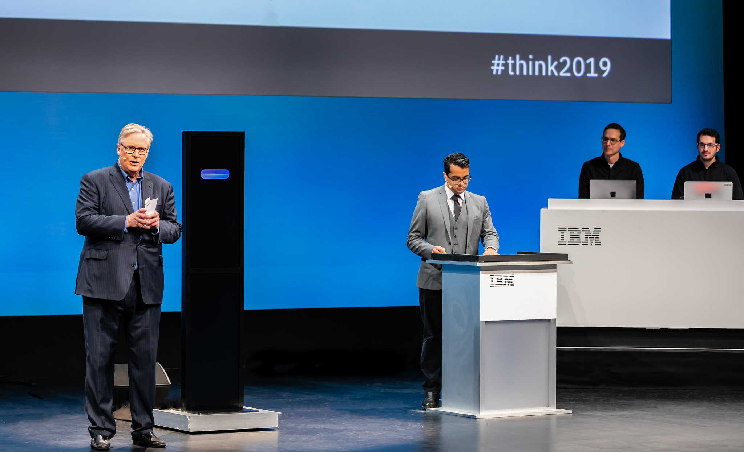
Motivation
„Well thank you very much everybody its a pleaure to be here for this historic event. And it certainly was a pleasure to listen to Project Debater. There was a lot of information in that speecs and lots of facts and lots of figuers.
The problem though is the reality of subsidizing preschools is one which does not deal with the underlying problems in society, it is one which often makes those worse, and in the end is little more than a politically motivated giveaway for the middle-class.”
Harish Natarajan, 2019

Slide 3
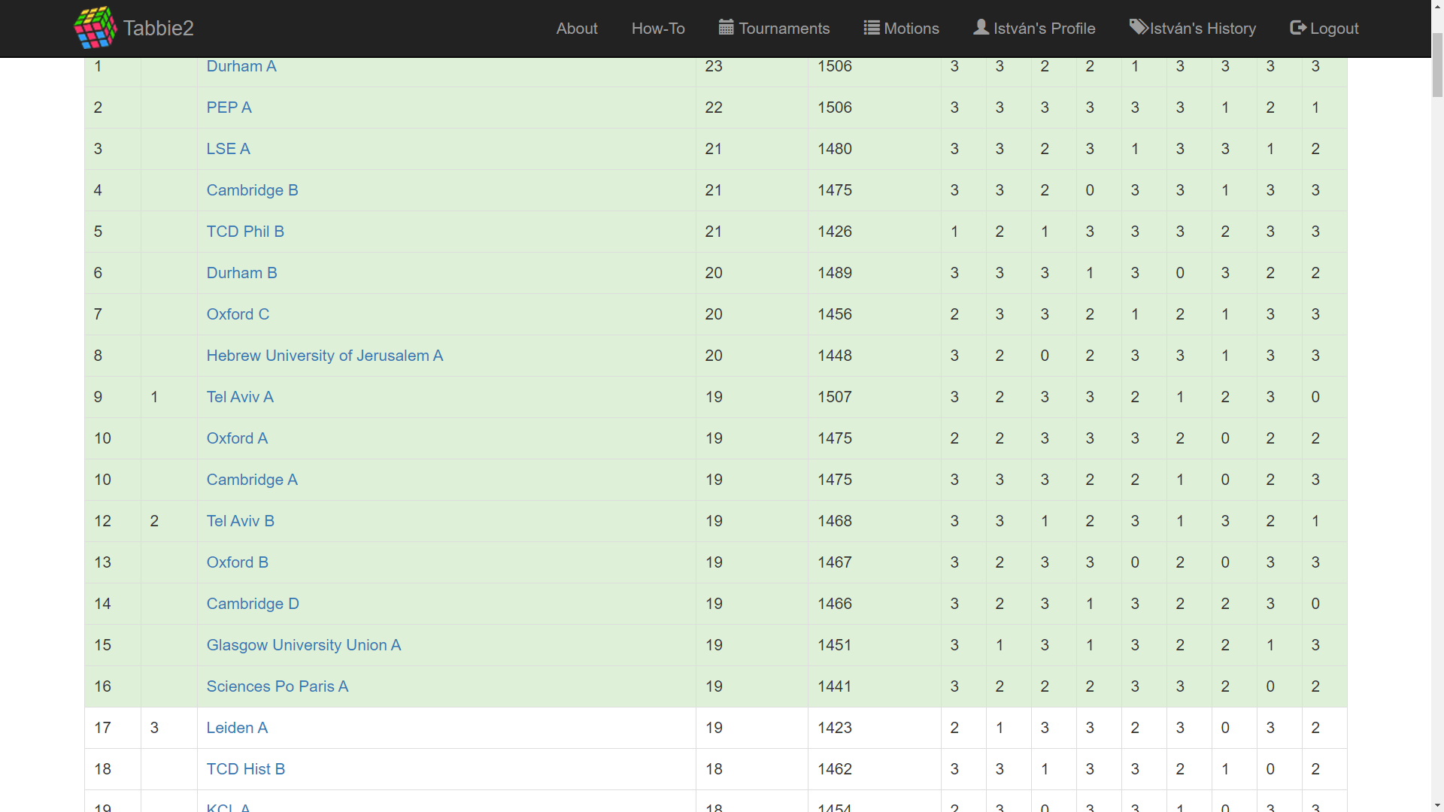

Slide 4
Opening Government
Closing Opposition
Opening Opposition
Closing Opposition
1
2
3
4
5
6
7
8

Slide 5
The conflict
OG
OO
CG
CO
Ranking | Teampoints | Speakerpoints
1st | 3 | X
2nd | 2 | ~ X-2
3rd | 1 | ~ X-4
4th | 0 | ~ X-6

